Slide 1
IntelliDoc
The Future of Intelligent Document Processing
Aditya Jangeti | Gudhi Sushma | Hridya Nair | Pranay Jaju | Yash Dabas
Under the guidance of: Sonu
IDP Team (Cloudwick)

Slide 2
Table of Contents
1
Industry
Challenge
Storage Tiers
2
Introduction
ADVANTAGES
3
01
4
Process Flow
Features
Co
Introduction
5
Storage Tiers
Storage Tiers
Real Life Applications
6
Why Choose Us?
Storage Tiers
Introduction

Slide 3
Industry Challenge
Businesses face an overwhelming influx of digital and physical documents. Outdated, manual processing methods hinder efficiency, and introduce significant financial and compliance risks.
Storage Tiers
Unstructured Data
Vast volumes of unstructured data in invoices, contracts, and forms.
Slow and Error-Prone
Manual data entry is slow. High human error rates lead to many issues.
Sensitive information
Inaccurately classifying sensitive information and exposing them.
Introduction

Slide 4
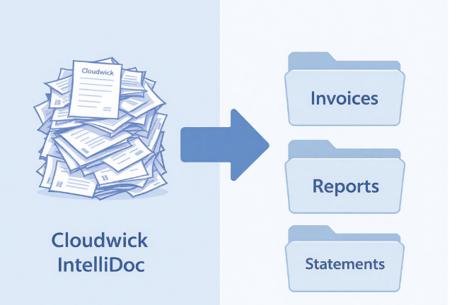
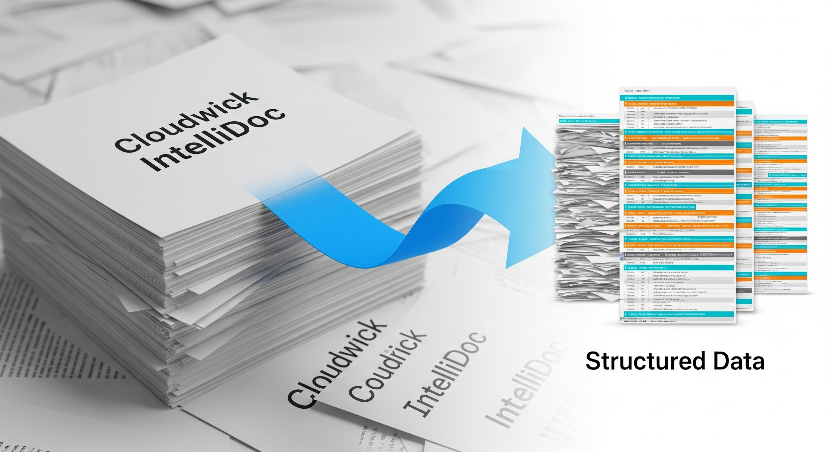
Our Solution: Cloudwick IntelliDoc
A next-generation Advanced Intelligent Document Processing (IDP) platform, leveraging cutting-edge AI to automate document understanding and data extraction, transforming chaotic paperwork into clear, actionable insights.
Introduction

Slide 5


Powered by Advanced AI
Cloudwick IntelliDoc is built on a robust foundation of state-of-the-art artificial intelligence technologies, ensuring unparalleled accuracy and efficiency in document processing.
Large Language Models (LLMs)
At the core of our platform, providing state-of-the-art understanding and reasoning for data extraction from complex, unstructured documents.
Optical Character Recognition (OCR)
High-fidelity conversion of scanned documents and images into structured, machine-readable text, enabling seamless AI processing.
Introduction

Slide 6
Process Flow
Cloudwick IntelliDoc streamlines document processing into an automated workflow that requires minimal human intervention.
DocVault
Create a docvault and add your files here
1
Ingest
Upload any document from multiple sources
2
Extract
The documents are extracted and classified
3
Review & Export
Extracted data is available for review and export
4
Introduction

Slide 7
What IntelliDoc Can Do
Cloudwick IntelliDoc offers a comprehensive suite of features designed to revolutionize your document workflows, ensuring precision and efficiency at every step.
Data Extraction
Pull key-value pairs, tables, and complex informations (.pdf, .jpg, .jpeg, .png)
Intelligent Classification
Automatically sort the documents by type
Fraud & PII Detection
Detects fraud and redacts sensitive information
Chatbot
Intuitively query on extracted documents with filters
Introduction

Slide 8
What IntelliDoc Can Do
IntelliDoc extends its capabilities to provide an end-to-end solution for your document processing needs, enhancing efficiency and accuracy across your operations.
User defined Classification
Users can upload 5 files to create a new classification
Human-in-the-Loop review
Users can view, edit, and confirm the generated output
Standardization
Specify data formats in the extracted fields for standardization
Dashboard
Displays statistics of files uploaded in the system
Introduction

Slide 9

Human Resources
Effortless Employee Record Management:
Employees securely upload documents like certifications and invoices to their "Employee DocVaults," centralizing all records.
Data Capture:
IntelliDoc automatically captures certification scores from training certificates and reimbursement amounts from invoices
Quick HR Queries:
HR can use the chatbot to instantly retrieve information
Introduction

Slide 10
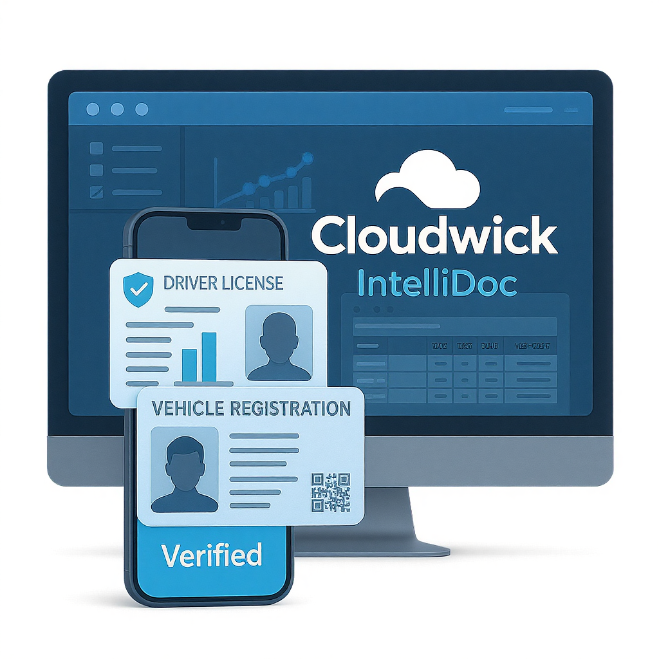
Transportation
Dedicated DocVaults:
Create "Drivers DocVault" for storing licenses, IDs and "Vehicles DocVault" for documents like insurance, registration papers
Integrated Fraud Detection for IDs:
Crucially, for critical documents like driving licenses, IntelliDoc instantly flags potential fraudulent or tampered documents
Data Isolation & Privacy Assurance:
Users can collaborate with confidence
Introduction

Slide 11

Healthcare
Effortless Patient Onboarding:
Patients or administrative staff upload intake forms and identity documents directly to designated patient DocVaults.
Data Extraction and Classification:
Extracting patient demographics, insurance details, and medical history, classifying documents like “Patient Intake”, “Lab Report”
Dashboard:
Real-time visibility of files statistics
Introduction

Slide 12
Why choose IntelliDoc?
Nanonets
Docsumo
Parabola
User has to select classification before uploading document
Limited unified extracted fields overview per classification
Absence of Fraud, PII Detection and Redaction
No interactive document querying
Non collaborative environment

Slide 13
Let’s get started with Demo…

Slide 14
Thank You
Discover the future of document processing with IntelliDoc
Cloudwick

